Slide 1

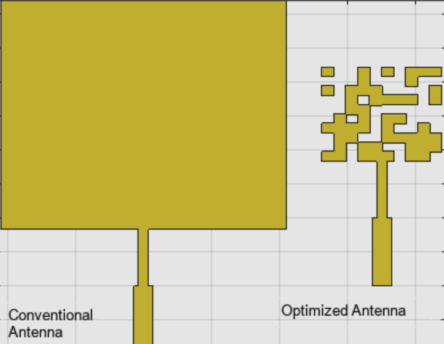
AP-S/URSI — Technical Workshop HD-7
AI in Antenna Design and Analysis: From
Pretrained Models to System-Level Integration
Part 3: Optimization
Sekhar Sekharan– sekhars@mathworks.com
Applications Engineer
MathWorks | RF/EM Group
Notes:
Build the RF digital twin of a beamformer from OTA measurements and with hardware knowledge coming from the datasheet.
Use the digital twin for system-level integration and exploration of different applications.
This work is based on the model of the Fujikura Type-C PAAM integrated beamformer:
MW96-11-22-0008(11)_Type-C_Brochure.pdf

Slide 2
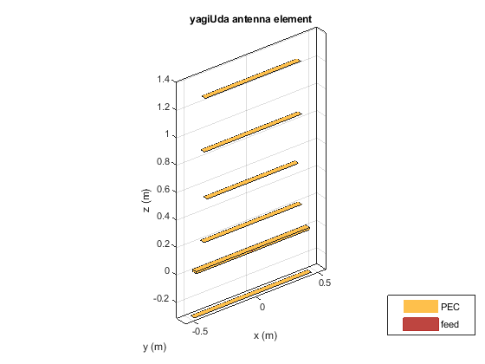
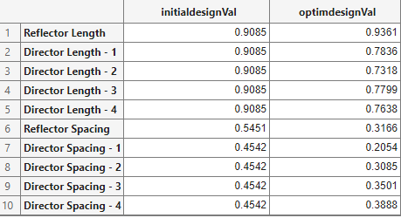
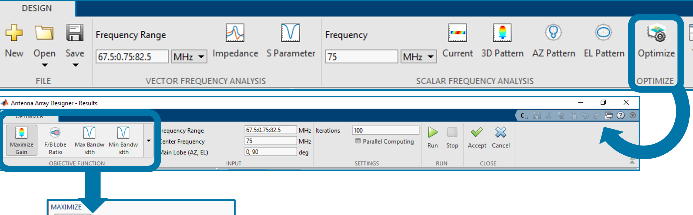
Why optimize antenna designs?
Antenna design is a coupled trade-space problem, not a one-knob tuning problem.
Geometry variables interact: length, spacing, substrate, feed, array layout
Targets compete: gain/directivity, return loss, bandwidth, side lobes, area
Constraints matter: packaging, fabrication rules, and installed performance
Optimization makes the search repeatable: variables + bounds + objective + constraints
Candidate variables and optimized values
Parameterized antenna geometry
App workflow: choose objective, run, review, accept
Optimization converts manual antenna tuning into a measurable design search.

Slide 3
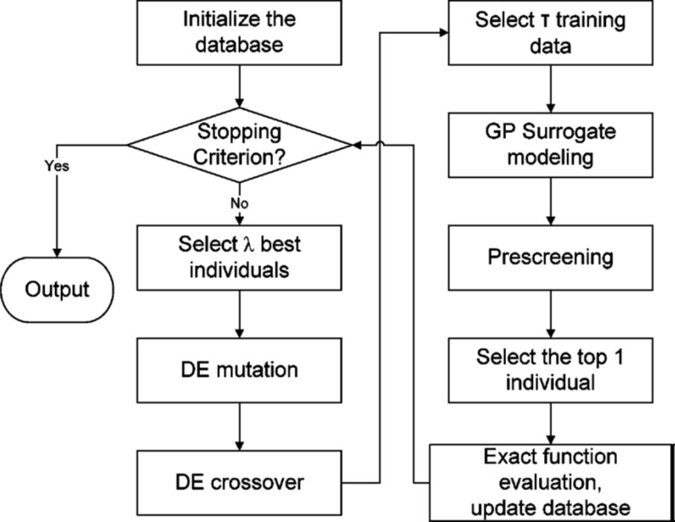
Why surrogate optimization?
Full-wave EM gives the truth, but evaluating every candidate design can dominate runtime.
Direct global search can need many EM simulations
Many proposed designs are poor and do not deserve a full solve
A surrogate model learns from sampled EM results and prescreens new candidates
Use it when design variables, constraints, or third-party EM loops make brute-force optimization too slow
Surrogate-assisted loop: sample → model → prescreen → EM verify
Keep EM as the source of truth; use the surrogate to decide where to spend EM time.

Slide 4
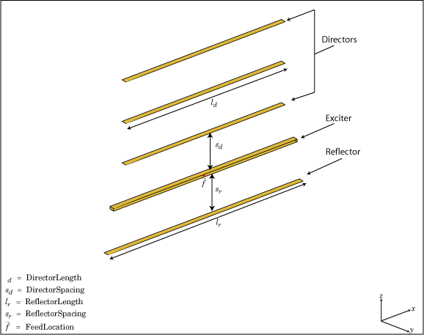
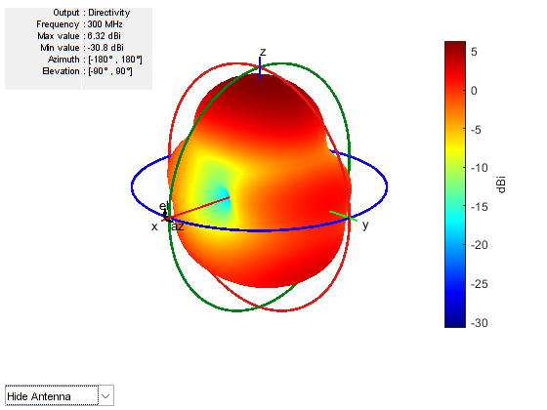
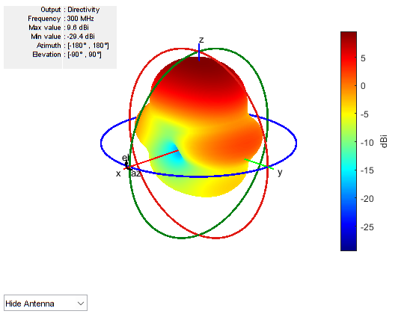
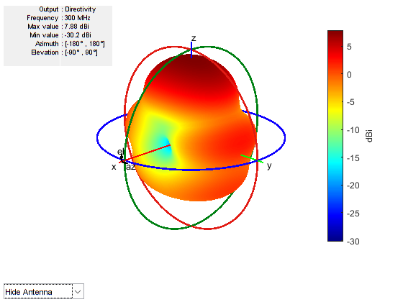
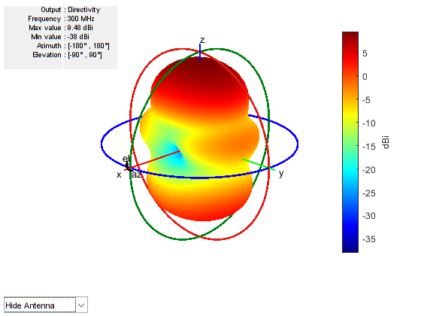
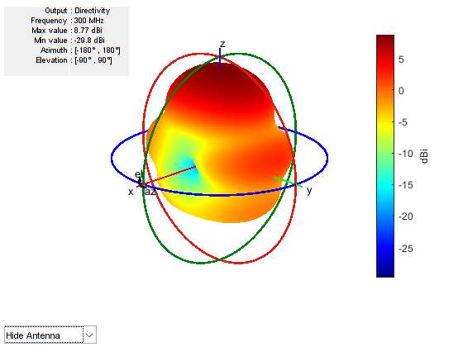
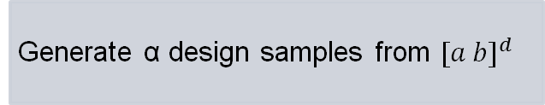
Surrogate-Based Optimization Collaboration with Prof. Bo Liu, Univ. Glasgow
Surrogate model Assisted Differential Evolution for Antenna synthesis (SADEA) is an AI-driven antenna design method
Generate α design samples from ${[a b]}^{d}$
Initialization
α design for reflector length from [0.1 1] meter
Select the β best candidate designs
Generate β child solutions
Prescreen β child solutions using Gaussian process surrogate model
Iteration
Stopping criteria
The specifications are met
Objective values does not improve for a certain number of iterations
Notes:
In Antenna Toolbox, you have found already for many years a surrogate based optimization method named SADEA developed in collaboration with prof. Bo Liu, from Univ. Glasgow.
Surrogate-based optimization utilize AI models that learn subsets of the design space as one proceeds along an optimization search curve. AI on the fly. The art of these technique is on how the design space is sampled in order to create the surface response.
Iteration steps
Select the best candidate designs to form a population P.
Apply the differential evolution to generate λ child solutions.
For each child solution, the nearest design sample is used as a training data point to construct a local Gaussian process surrogate model.
Carry out an EM simulation to the best child solution, add this simulated candidate design and its function value to the database.
Stopping criteria
The specification(s) is (are) met.
The standard deviation of the population is smaller than a threshold and the current best objective function value does not improve for a certain number of iterations. (It is better to be controlled using the figure displaying the convergence trend).
The computing budget (the number of EM simulations) is exhausted. Note that the number of EM simulations can be added anytime.

Slide 5
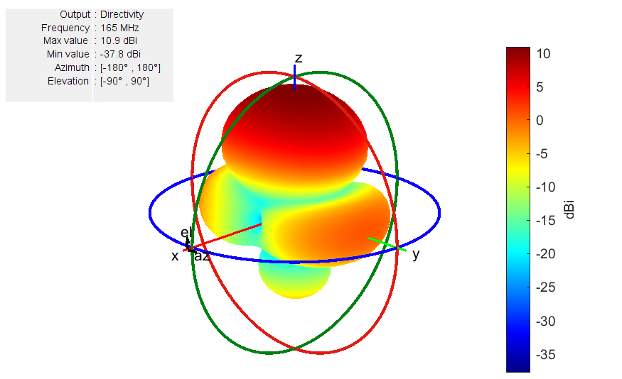
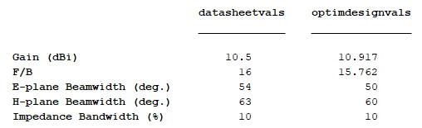
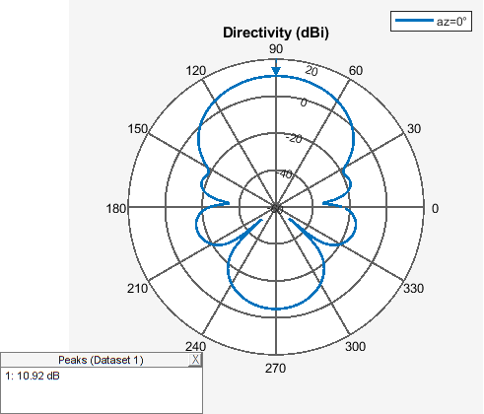
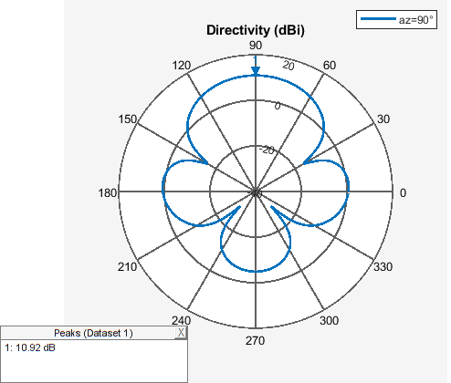
SADEA: Yagi-Uda Optimization Example
E-plane
H-plane
SADEA Optimization of Six-Element Yagi-Uda Antenna using Custom Objective Function https://www.mathworks.com/help/antenna/ug/optimize-yagiuda-using-custom-objective-function.html
Notes:
Here is the one possible optimized Yagi-Uda design by SADEA.
What is interesting here is that the obtained performance compares favorably with the performance of an actual Yagi-Uda antenna that operates at this frequency. In other words, the solution is feasible and makes sense!

Slide 6
Optimization Exercise

Slide 7

Antenna Workflow #3: Optimization with (better) AI
Import
Post
process
Antenna Design
EM
Integrate
Optim.
AI
Export
Do you design antennas with a large number of design variables?
Do you need to speed up antenna optimization?
Do you use 3rd party EM tool and would like to use MATLAB for optimization?
Notes:
But what if you design antennas with a large number of design variables?
And you need to speed up antenna optimization even further?
Or you might be you using CST or HFSS and would like to use MATLAB for optimization?

Slide 8
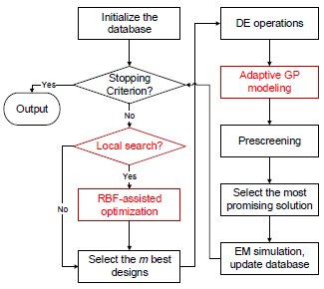



AI for Surrogate Based Optimization
Sample to be predicted
GP model
TR (Training-cost Reduced) – SADEA
Faster, while converging to a good solution
Adaptive Gaussian Process predictions
Handle up to 80 design variables
Enabled in apps and command line
SADEA
TR-SADEA
Individual modelling
Very accurate prediction
Too many models hence time-consuming
Adaptive modelling
K-means clustering, adaptive number of GP modelling
Reduced time consumption while maintain accuracy
Notes:
TR-SADEA is an enhanced version of the SADEA algorithm designed to further reduce the computational cost associated with the training of surrogate models.
TR-SADEA implements a trade off between the accuracy of the surrogate model and the computational resources required for its training by minimizing the number of training samples. By using adaptive sampling it ensures that computational resources are directed towards the most promising regions of the search space.
Local search, which is faster, is also used to find a solution, helps in pushing the optimization ahead quickly during the initial iterations. Clustering of candidates generated by DE , helps minimizing the number of Gaussian models that are required.
Despite the reduced training cost, TR-SADEA maintains high optimization accuracy by strategically managing the surrogate model

Slide 9
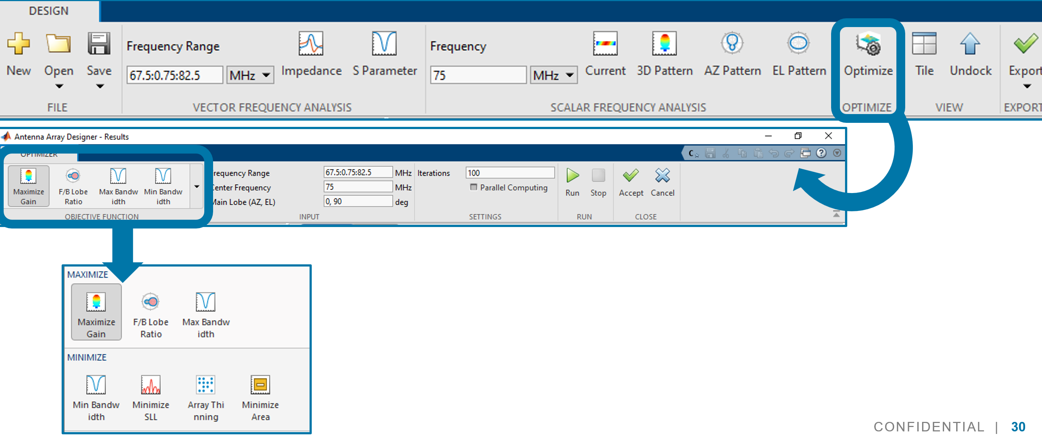
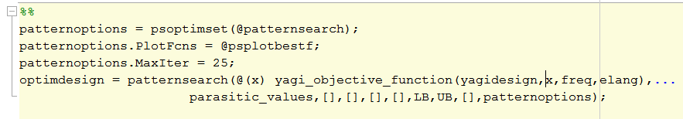
Antenna Optimization - Summary
Standard objective functions available in the apps
SADEA, TR-SADEA, Surrogate optimization
Support for geometric constraints and integration with RF PCB Toolbox
Custom objective functions can be defined at the command line
Interface for SADEA and TR-SADEA available
Can be used with 3rd party EM tools
Notes:
Now, how can you use TR-SADEA?
You find it already available out of the box in the Antenna Toolbox apps, together with SADEA, and a general purpose sourrogate optimization method.
And you can use it from the MATLAB Command line, for advanced applications where you can build you own custom objective function.

